Slide 1




SQL Workshop
Sign-in Sheet
Davis Data Science Club
What is SQL?
Commands
Exercises
Join anonymous Q&A at slido.com
Code: #1959 758

Slide 2
Creating Your SQL Workspace
Sign-in Sheet
Navigate to mode.com
Sign up for a free account
Name your Workspace and URL - you can put anything you want
Click “Start using Mode with sample data”
Navigate to the plus icon on the top right to create a new report
Select “Write SQL”
Type SELECT * FROM tutorial.accounts onto the report to access some sample database
Join anonymous Q&A at slido.com
Code: #1959 758
Notes:
Aditya
2-3 mins
Mode.com : allows us to practice executing SQL queries on test datasets for free. Saves time from having everyone download a SQL workbench.
Prolly j demonstrate step 5 onwards (perhaps find a way to show steps 2-4?)

Slide 3
What is SQL and why should we learn it?
Structured Query Language - Used in Database Administration, Application Development, and Data driven websites
Databases and information stored within them
Uses simple concise code to store information in a proper way that can easily be accessed
SQL knowledge is required for data scientists, data analysts, database administrators/architects, and software developers
Join anonymous Q&A at slido.com
Code: #1959 758
Notes:
Query language means that it has to do with specific procedure regarding databases and the information stored in them
So SQL is used to communicate with databases, it’s a pretty easy language to use in order to deal with them
Nisha
2 min

Slide 4
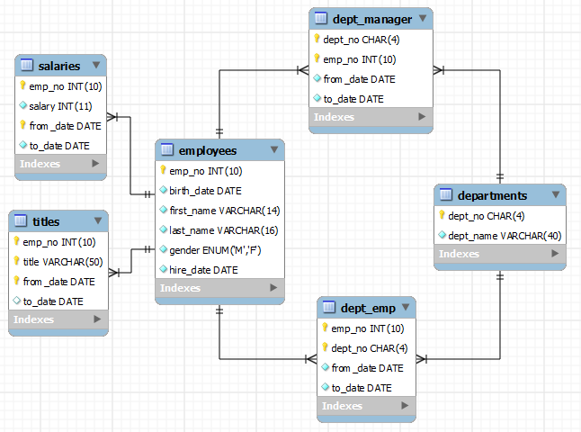
Databases
Scalable storage system
Manages collections of data & relationships between datafiles
Structure and organized data where it can be easily accessed, managed, and updated
Join anonymous Q&A at slido.com
Code: #1959 758
Notes:
There’s a structure here to the data, all having to do with employee information, then there are different tables with specific categories where the rest of the information is stored
2 min
Structured Query Language
Database = warehouse
Data tables = filing cabinets
Data = files
Data lake - vast pool of raw data (data warehouse is structured, filtered data) - purpose of data is not yet determined
Nisha

Slide 5
SQL - Accessing Data
Join anonymous Q&A at slido.com
Code: #1959 758
SELECT
* (must be from the database table referred in FROM command)
FROM <database table> (more complex commands exist after FROM, such as joins)
WHERE <condition for the table> (AND, OR, NOT operators)
GROUP BY <variable(s)>
HAVING <condition for the groups>
ORDER BY <variable(s)>
LIMIT <integer>;
Double hyphen (--) or forward slash and asterisk /* */ to comment
Semicolons used to end sql statements (not necessary in all databases)
Notes:
4 min
Nisha

Slide 6
Code
Slide 6
--SELECT * FROM tutorial.accounts; -- Selecting all cols/rows from the tutorial.accounts data table
--SELECT id FROM tutorial.accounts
-- SELECT COUNT(sales_rep_id) FROM tutorial.accounts; -- Count number of total non-null values in the sales_rep_id column (354)
-- Distinct returns one of each distinct value in the column
-- SELECT COUNT(DISTINCT(sales_rep_id)) FROM tutorial.accounts -- Count number of distinct/unique sales representatives (50)
Slide 7
--SELECT * FROM tutorial.accounts WHERE id>2501 AND sales_rep_id > 321830
--SELECT * FROM tutorial.accounts WHERE NOT id>2501
-- SELECT * FROM tutorial.accounts WHERE id BETWEEN 2501 AND 3000 LIMIT 3;
-- SELECT * FROM tutorial.accounts WHERE primary_contact LIKE '%er'; -- all primary contacts whose name end in "er".
SELECT * FROM tutorial.accounts WHERE primary_contact LIKE '%han%'; -- all primary contacts whose name contains "han".
Slide 8
-- SELECT COUNT(name) FROM tutorial.accounts GROUP BY region_id; -- get number of companies grouped by region id
-- SELECT * FROM tutorial.accounts ORDER BY primary_contact ASC -- ordered A to Z
SELECT * FROM tutorial.accounts ORDER BY primary_contact ASC, name DESC -- if same primary contact in multiple rows, order company name Z-A
-- SELECT COUNT(id), sales_rep_id FROM tutorial.accounts GROUP BY sales_rep_id -- get number of accounts serviced by each sales representative
-- SELECT COUNT(id), sales_rep_id FROM tutorial.accounts GROUP BY sales_rep_id HAVING Count(id)>5 -- get number of accounts serviced by each sales rep. Filter out sales reps with 5 or less accounts
-- SELECT COUNT(id), sales_rep_id FROM tutorial.accounts GROUP BY sales_rep_id WHERE Count(id)>5 -- Doesn't work, Where can't be used with aggregate functions

Slide 7
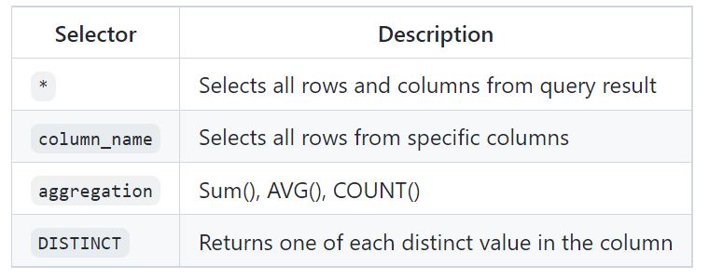
SELECT Statement
SELECT: What data you want to retrieve?
FROM: Which data table you want to query from
Join anonymous Q&A at slido.com
Code: #1959 758
Notes:
Aditya
(4 mins)
General process: a cycle of going over a few concepts, showing some sample queries and then have yall do a few exercises on your own
Most basic SQL command: Select statement: used to fetch data from a database. Broken down into 2 key words:
Select: which data to select from a database.
From: specify which data table we want to query from.
Let’s go over some example queries.
-- SELECT Command --
-- SELECT * FROM tutorial.accounts; -- Selecting all cols/rows from the tutorial.accounts data table
-- SELECT id FROM tutorial.accounts; -- Select all rows from only the id column
-- Usage of aggregations! (Aggregation functions: calculation on a set of values, and returns a single summarized result (ex sum, avg, count))
-- SELECT COUNT(sales_rep_id) FROM tutorial.accounts; -- Count number of total non-null values in the sales_rep_id column (354)
-- Distinct returns one of each distinct value in the column
-- SELECT COUNT(DISTINCT(sales_rep_id)) FROM tutorial.accounts -- Count number of distinct/unique sales representatives (50)

Slide 8
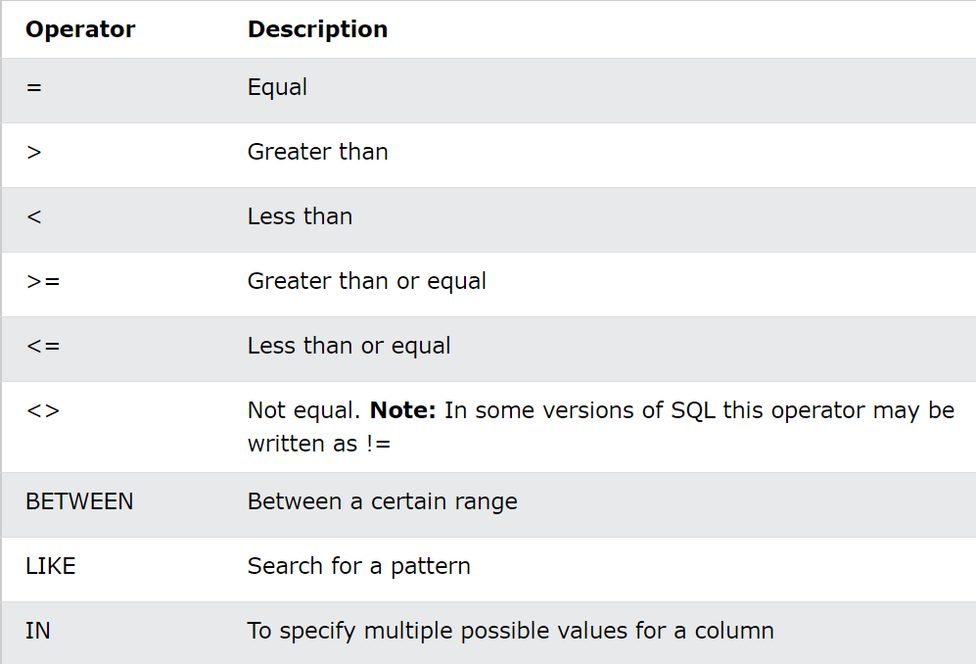
Commands
WHERE: filter records due to specified condition
AND, OR, NOT operators
LIMIT: set limit on number of rows returned
LIKE: search for specified pattern in a column (e.g. string patterns)
Wildcards: placeholder for string character(s)
% : 0 or more characters
_ : 1 singular character
Join anonymous Q&A at slido.com
Code: #1959 758
Notes:
Aditya
(5)
Where : used to filter our data based on specified conditions. And or not logical operators often used to accommodate multiple conditions. In the chart on the right, are some relational operators also used to help filter out data. Limit used to set a hard cap on the number of rows we want returned in the result
Like is also used in Where clauses to help search for specific patterns in a column. Most commonly used in string patterns in a column (ex. Retrieve all names in a column that start with the letter ‘a’).
When searching for string patterns (usually on the rarer side in SQL queries), wildcards are often used (character placeholders). % 0 or more characters, _ is 1 singular character
-- SELECT * FROM tutorial.accounts WHERE id>2501 AND sales_rep_id > 321830
-- SELECT * FROM tutorial.accounts WHERE NOT id>2501
SELECT * FROM tutorial.accounts WHERE id BETWEEN 2501 AND 3000 LIMIT 3;
-- SELECT * FROM tutorial.accounts WHERE primary_contact LIKE '%er'; -- all primary contacts whose name end in "er".
SELECT * FROM tutorial.accounts WHERE primary_contact LIKE '%han%'; -- all primary contacts whose name contains "han".

Slide 9
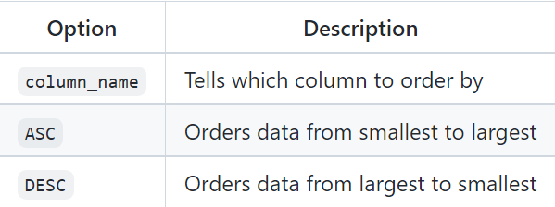
Commands
GROUP BY: groups by the values of a variable of interest. You can pair count() or other aggregation functions on all rows with that column value
Ex: group customers by country
HAVING: Similar to WHERE, but can be used with aggregate functions unlike WHERE
ORDER BY: sort the result-set in ascending or descending order. You can order by multiple columns
Join anonymous Q&A at slido.com
Code: #1959 758
Notes:
Aditya
(6 mins)
Now onto group by: groups rows with same values in a column together. Group by is often used with agg functions to __
Having
Order by
-- SELECT COUNT(name) FROM tutorial.accounts GROUP BY region_id; -- get number of companies grouped by region id
-- SELECT * FROM tutorial.accounts ORDER BY primary_contact ASC -- ordered A to Z
SELECT * FROM tutorial.accounts ORDER BY primary_contact ASC, name DESC -- if same primary contact in multiple rows, order company name Z-A
-- SELECT COUNT(id), sales_rep_id FROM tutorial.accounts GROUP BY sales_rep_id -- get number of accounts serviced by each sales representative
-- SELECT COUNT(id), sales_rep_id FROM tutorial.accounts GROUP BY sales_rep_id HAVING Count(id)>5 -- get number of accounts serviced by each sales rep. Filter out sales reps with 5 or less accounts
-- SELECT COUNT(id), sales_rep_id FROM tutorial.accounts GROUP BY sales_rep_id WHERE Count(id)>5 -- Doesn't work, Where can't be used with aggregate functioms

Slide 10
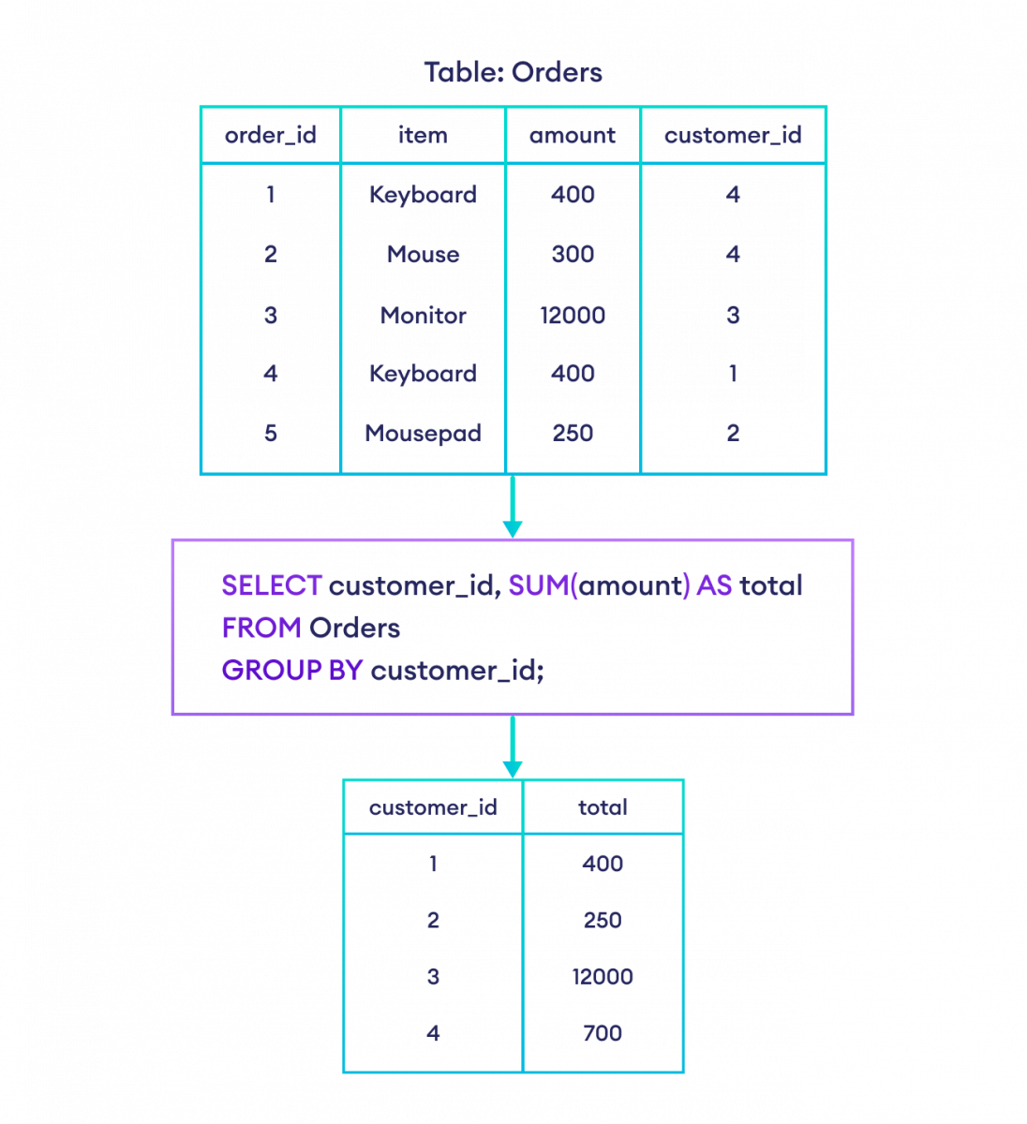
GROUP BY
Example
Join anonymous Q&A at slido.com
Code: #1959 758
Notes:
(2 mins) Explain with group by first, then from, then select

Slide 11
Exercise 1 - Accessing Data
Find the distinct count of companies in the table.
Retrieve the name of the company whose id number is 1401.
Select all rows from the “name” and “primary_contact” columns only
Tougher Questions:
In 1 query, find the name of the primary contacts for Walmart, Best Buy, and Alphabet. Order the output alphabetically based on the primary contact.
Get a list of all primary contacts whose last name has 5 characters and ends in ‘le’. Which companies do they represent?
Hints: Select … FROM tutorial.accounts …
Join anonymous Q&A at slido.com
Code: #1959 758
Notes:
aditya

Slide 12
Exercise 1 - Solutions
SELECT COUNT(DISTINCT(name)) FROM tutorial.accounts;
SELECT name FROM tutorial.accounts WHERE id = 1401
SELECT name, primary_contact FROM tutorial.accounts;
SELECT name, primary_contact FROM tutorial.accounts WHERE name IN ('Walmart', 'Best Buy', 'Alphabet') ORDER BY primary_contact ASC;
SELECT * FROM tutorial.accounts WHERE primary_contact LIKE '% ___le'; -- 3 underscores. name column with exactly 4 characters preceding character 'er'.
PBF Energy, Genworth Financial
Join anonymous Q&A at slido.com
Code: #1959 758
Notes:
aditya
SELECT name FROM tutorial.accounts WHERE id = 1401
SELECT * FROM tutorial.accounts WHERE id = 1401

Slide 13
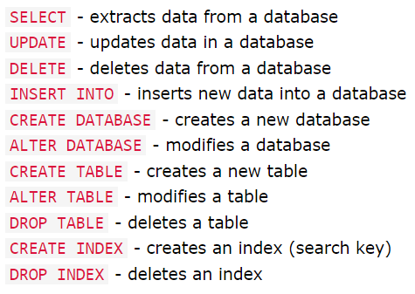
SQL - Changing Data
With these types of commands, be cautious of the changes you are making! It can lead to serious problems in your projects
Join anonymous Q&A at slido.com
Code: #1959 758
Notes:
Nisha
2 min
Indexes are used to retrieve data from the database more quickly than otherwise. The users cannot see the indexes, they are just used to speed up searches/queries.
https://www.programiz.com/sql/online-compiler/#google_vignette

Slide 14
Code 2
/*SELECT first_name, age
FROM Customers;*/
-- add col, drop col, change data type
/*ALTER TABLE Shippings
RENAME COLUMN customer to customer_id;*/
/*UPDATE Customers
SET first_name='Katie' WHERE age=22;*/
--DELETE FROM Customers WHERE last_name='Doe';
/*INSERT INTO Orders
VALUES (6,'Monitor', 12000, 2)*/
/*INSERT INTO Orders (order_id, item)
VALUES (7, 'Laptop'); */
/*INSERT INTO Orders
VALUES (8,'Monitor', 12000, 2),
(9,'Mouse', 300, 4),
(10,'Laptop', 15000, 3);*/
/*CREATE TABLE Employees (
employee_id int,
first_name varchar(100),
last_name varchar(100),
City varchar(100)
);*/
/* varchar is the maximum amount of characters that can be stored in the string type column */
/*DROP TABLE Employees;*/
Notes:
Nisha
10 min
https://www.programiz.com/sql/online-compiler/#google_vignette

Slide 15
Exercise 2 - Changing Data
Using another compiler for this - search up Programiz Online SQL Editor
https://www.programiz.com/sql/online-compiler/
Change all items in the Orders table to ‘Mousepad’
Add a new column to Shippings named lbs with the data type integer
Drop the column age in Customers
In the Shippings table, fill out the null values in the lbs column as three times the customer value
Create a new table called Planning with the customer_id and last_name columns from the Customers table
Join anonymous Q&A at slido.com
Code: #1959 758
Notes:
Nisha
5 min

Slide 16
Exercise 2 - Solutions
/*UPDATE Orders
SET item='Mousepad';*/
/*ALTER TABLE Shippings
ADD COLUMN lbs integer;*/
/*ALTER TABLE Customers
DROP COLUMN age;*/
/*UPDATE Shippings
SET lbs=3*customer;*/
/*CREATE TABLE Planning AS
SELECT customer_id, last_name
FROM Customers;*/
Notes:
Nisha
5 min

Slide 17
Joins
Retrieves data from two or more tables in one query
Very useful since relevant data is often contained in multiple tables
You need a column that is the same in both tables that you are trying to join (usually an ID, or some other key)
Four main types
General syntax:
SELECT * FROM table1 ____ JOIN table2 ON table1.ID = table2.ID;
Join anonymous Q&A at slido.com
Code: #1959 758
Notes:
Cindy

Slide 18
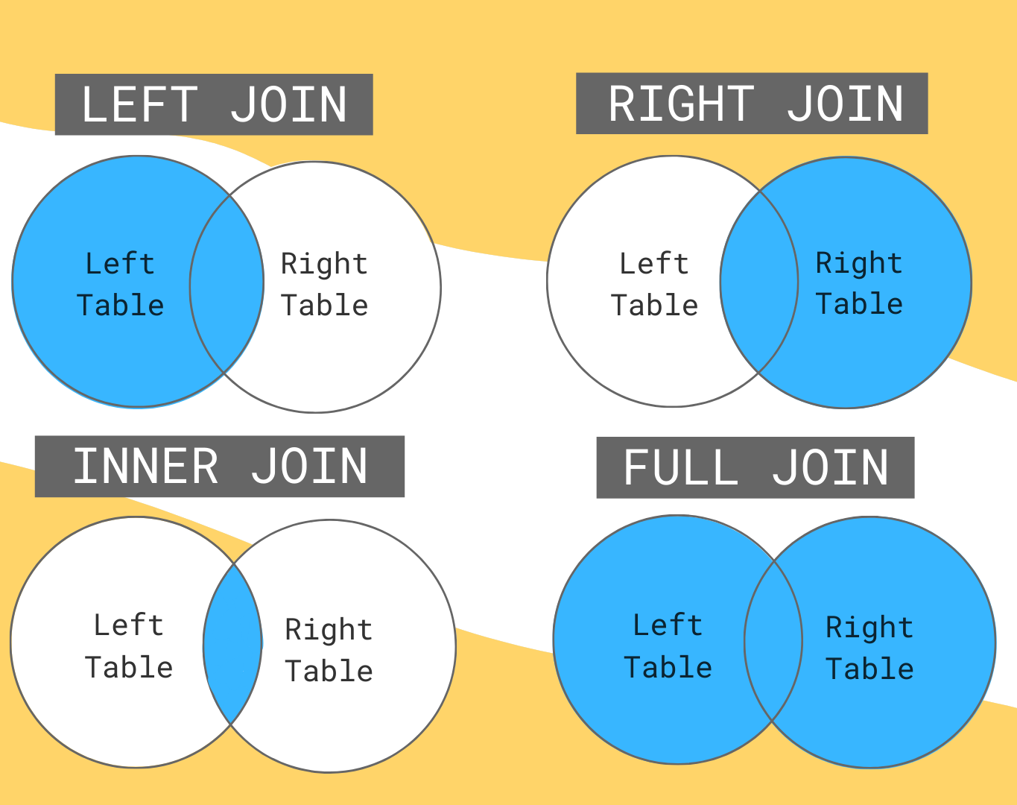
4 Types of Joins
Left Outer Join: Return all records from left table, and matched records from right table
Right Outer Join: Return all records from right table, and matched records from left table
Inner Join: Return records with matching values in both tables
Full Outer Join: Returns all records when there is match on either left or right side
Join anonymous Q&A at slido.com
Code: #1959 758
Notes:
Cindy
By default, JOIN by itself refers to an INNER JOIN
For inclusive joins, such as an inclusive LEFT JOIN where we keep all rows from the left table:
If there is no matching row in the right table: there will be NULL instead
Same for inclusive RIGHT JOINs and FULL JOINs

Slide 19
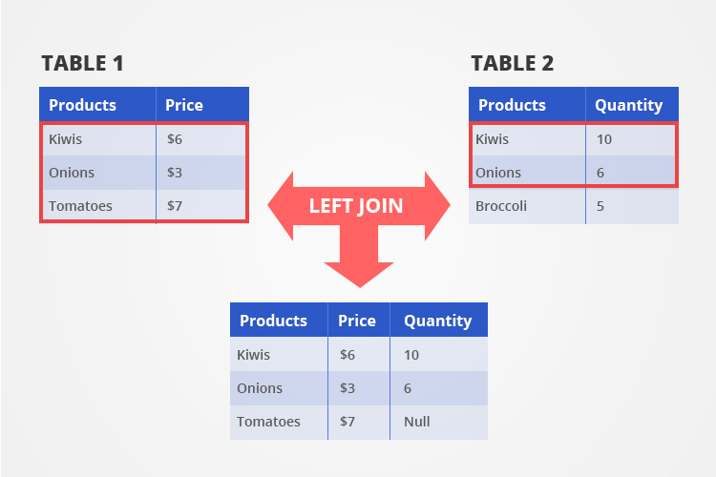
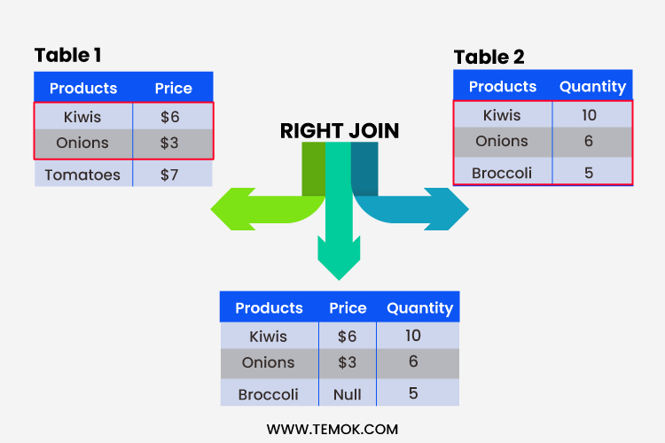
Joins (Examples)
Join anonymous Q&A at slido.com
Code: #1959 758
SELECT * FROM Table1
LEFT JOIN Table2 ON Table1.Products = Table2.Products;
SELECT * FROM Table1
RIGHT JOIN Table2 ON Table1.Products = Table2.Products;
Notes:
Cindy
Stop for questions!!

Slide 20
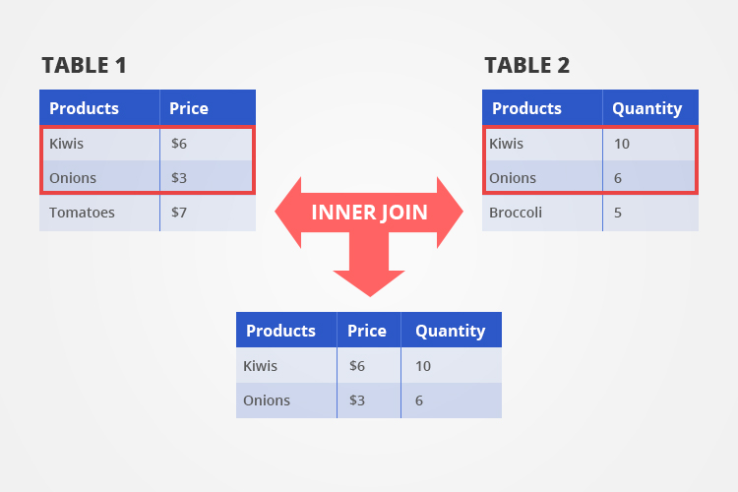
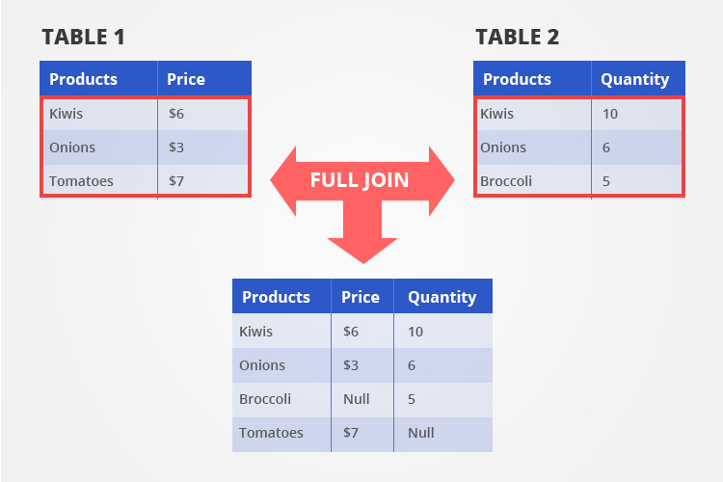
Joins (Examples)
Join anonymous Q&A at slido.com
Code: #1959 758
SELECT * FROM Table1
(INNER) JOIN Table2
ON Table1.Products = Table2.Products;
SELECT * FROM Table1
FULL JOIN Table2 ON Table1.Products = Table2.Products;
Notes:
Cindy
Should be no NULL records in a Inner Join

Slide 21
Joins
When joining, you want to specify the table name before the column names, separated by a period (.)
SELECT table1.products, table1.price, table2.quantity FROM table1 INNER JOIN table2 ON table1.products = table2.products;
General tip: You can use AS to rename your tables within the code (helpful for joins since you will refer to the table names frequently)
SELECT t1.products FROM table1 AS t1;
Join anonymous Q&A at slido.com
Code: #1959 758
Notes:
Cindy
Something else to add - renaming tables
ex: table1 as t1, table2 as t2, this way it is easier when you refer to them later in your code??
We can also do inner joins using the WHERE operator instead of JOIN
Ex: SELECT * FROM table1, table2
WHERE table1.ID = table2.ID
Helpful to specify the tables before a period (.) followed by the column name, in case your two tables have the exact same column name
Can still include other conditions by adding “AND ___”

Slide 22
Joins
Helpful to familiarize yourself with self joins, which is joining a table with itself
Won’t cover today but can be very useful
Can also expand joins to three or more tables!
Join anonymous Q&A at slido.com
Code: #1959 758
Notes:
Cindy

Slide 23

Exercise 3 - Joins
The table animal_crossing_villagers contains data on the villagers in Animal Crossing (name, personality traits, house types)
The table animal_crossing_wallpaper contains data on the types of wallpapers in Animal Crossing (buy price, sell price, colors, etc.)
Using the above tables, return a table that contains the names of ALL the villagers in Animal Crossing, their species, the type of wallpaper they have, and the buy and sell prices of their wallpaper.
Hints: What type of join is this if we want to keep ALL the villagers in our result table? What is the common column in the two tables?
Check: Your result should have 5 columns.
Join anonymous Q&A at slido.com
Code: #1959 758
Notes:
Cindy
Notes: Typically best practice to join on something like a unique numerical ID, since you can always have an issue of things being entered slightly diff in diff tables
Even extra spaces, hyphens, etc. will throw it off since JOINs look for EXACT matches
But here, we can assume that the way wallpaper name was entered in both tables is exactly the same :)

Slide 24
Exercise 3 - Solutions
SELECT villagers.name, villagers.species, villagers.wallpaper, wallpaper.buy, wallpaper.sell
FROM tutorial.animal_crossing_villagers AS villagers
LEFT JOIN tutorial.animal_crossing_wallpaper AS wallpaper
ON villagers.wallpaper = wallpaper.name;
Note: Renamed the source tables using the AS operator so that code is slightly clearer!

Slide 25
Resources:
Beginner
W3School Tutorial: https://www.w3schools.com/sql/
Advanced:
SQL Interview Questions: https://datalemur.com/
Run SQL Online:
https://www.programiz.com/sql/online-compiler/
https://mode.com/ Use public datasets to practice commands

Slide 26


Sign-in Sheet
Thank you!
IG: @data.ucd
FB: facebook.com/data.ucd
Website: davisdsc.com
GitHub: Davis-Data-Science-Club
Discord: discord.gg/zCPRKHdM7
Linktree: linktr.ee/davisdsc
Notes:
QR code in case ppl need to sign in
https://linktr.ee/davisdsc
https://discord.gg/zCPRKHdM7
www.davisdsc.com
www.facebook.com/data.ucd

